Slide 1
What is an Organization?
Collectivity of parts that can’t accomplish goals as effectively if they operate separately

Slide 2
3 Main Principles
Organizations are composed of systems and subsystems
Any system performs simple tasks
  transformation of input to output
All organizations (systems) have goals
  survival

Slide 3

Social Systems
Roles
Norms
Culture

Slide 4
Organizational Culture
Provides understanding of “the way things are done around here”
  1) Has a boundary defining role; it creates distinctions between one organization and another
  2) Conveys a sense of identity for organization members
  3) Facilitates the generation of commitment to something larger than one person’s self interest
  4) Enhances social system stability
  5) Guides and shapes the attitudes and behaviors of employees.
Notes:
But culture can also be a liability…and a barrier
BUT Can be a barrier to change, to diversity, to acquisitions and mergers

Slide 5
Organization Development (OD)
….is the SYSTEM-wide application of PLANNED development and change to IMPROVE the organization’s effectiveness

Slide 6
3 Parts of a Change or Transformation
Client
Change Agent
Intervention

Slide 7
Role of Consultant or Change Agent
Problem Identifier (Diagnostic/Catalyst)
Problem Solver (Confrontational/Prescriptive)
Inter-group activities
Education and training
Coaching and counseling
Life and career planning activities

Slide 8

Implementing Any Change
Creating an atmosphere for change
Communicating details
  training is needed
  two-way communication
  honesty is essential
Time frame
Training needs

Slide 9
I. Organizational Culture Change
Altering underlying values, systems, and beliefs
Easier said than done
There are many mental and physical “ways we have always done things”
People must be change agents
Examine and rid of “sacred cows”

Slide 10
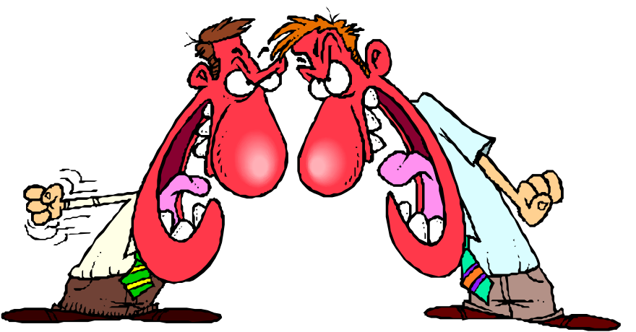
Maintaining the New Culture
Select new employees who are consistent with the new culture
Create a socialization process where new employees will learn about the new culture
Reward behaviors consistent with the new culture

Slide 11
II. Total Quality Management (TQM)
Comprehensive approach to making behavioral changes along with the business strategy
Uses statistical information to aid in decision-making
Also called continuous process improvement, quality improvement processes

Slide 12
Quality Education System
Managing quality
Identifying requirements of work process/job
Preventing problems
Understanding zero defects
Calculating the price of nonconformance; measuring quality
Developing teamwork
Measuring to improve and communicating results
Analyzing problems
Eliminating problem causes
Improving supplier/customer relationships

